Slide 1
Classification of renal cell carcinomas through ct texture feature analysis
anishsanjay nayak

Slide 2
introduction
Renal Cell Carcinoma (RCC) – Cancer of the adult kidney’s filtration system
Makes up to about 85% of all cancer diagnoses related to the kidney
Types of RCC
Clear cell
Accounts to 70% of RCC diagnoses
Can be classified into slow-growing (Grade1) to fast-growing (Grade 4)
Papillary
Accounts to 10%-15% of RCC patients
Classified into 2 subtypes – type1 & type2
Notes:
1. RCC develops in the renal tubules which make up the kidney’s filtration system
2. I’m going to be focusing on Renal Cell Carcinoma, even though there are other types kidney tumors
Because of its high rate of occurrence and, therefore, statistically higher mortality rate
3. 2 types and breakdown of % occurrence rates are provided
4. I’ll be focusing on 4 subtypes of clear cell and 2 subtypes of papillary RCC

Slide 3
motivation
Quantify the heterogeneity of the tumor to determine whether it is possible to predict which ones are suitable candidates for treatment by radiation therapy.
Develop a classifier algorithm that accurately categorizes kidney CT scans into the various subtypes by
Extracting specific key features from the tumor region of interest (ROI)
Identifying and training a learning algorithm that labels the feature vector
Notes:
- 3 datapoints required for accurate treatment
- Where the tumor is located; the type of the cancer; how aggressive it is or the subtype
- This paper intends to develop a classifier algorithm that categorizes kidney tumors by extracting features and training a labeling algorithm

Slide 4
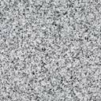
methodology
CC1 8 013
CC2 4 064
CC3 5 555
CC4 28 945
Feature extraction
Classification algorithms

Slide 5
Classifier inputs
The feature vector that is extracted includes the following:
Gray Level Correlation Matrix (GLCM) – 20 features
Gray Level Run Length Matrix (GLRLM) – 11 features
Hu’s Moments – 7 features
The grade responses used are clubbed into
Low-grade (grades 1&2)
High-grade (grades 3&4)
Notes:
In all the properties, the GLCM is used and iterated over
N is the number of gray levels in the image
1 more feature called as inertia is being used in my project apart from these 7 features

Slide 6
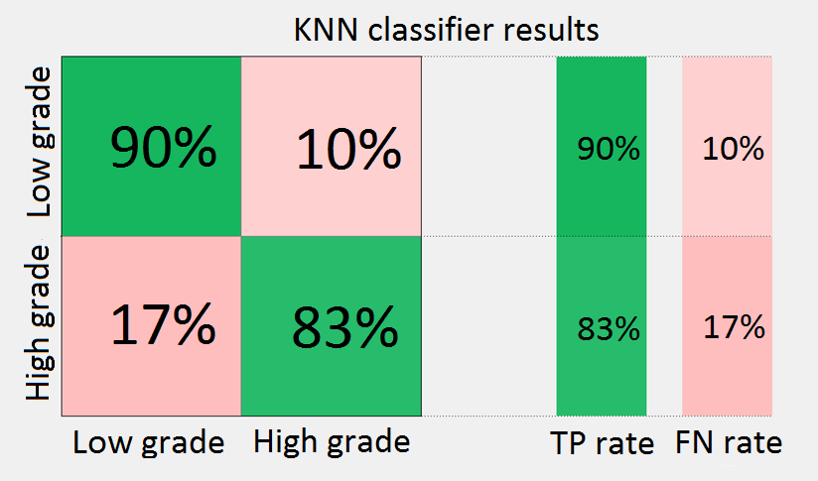
Classifier results
Total number of observations: 77
10-fold cross validation used
Best classifier algorithm: K-nearest neighbor (KNN) with k=1
Average accuracy over 5 trials: 91.42%
Area Under the Curve (AUC): 0.91

Slide 7
conclusion
The set of feature vectors selected leads to a consistent >90% accuracy for the KNN classifier
Redundant features depend on the texture in question
To be used on CT scans
Resolution of ROI should be high enough to be able to capture the features effectively
Notes:
Hypothesis 1 proved

